Slide 1
Self-Check Laboratory Exercise II (Decoders & Demultiplexers)
Anthony Ramos

Slide 2
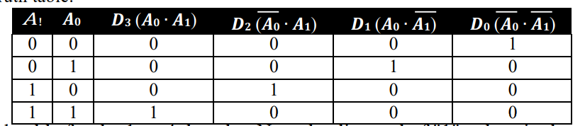
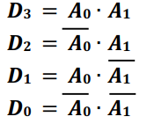
2-to-4 Decoder
Figure 1: Truth Table for 2-4 Decoder

Slide 3
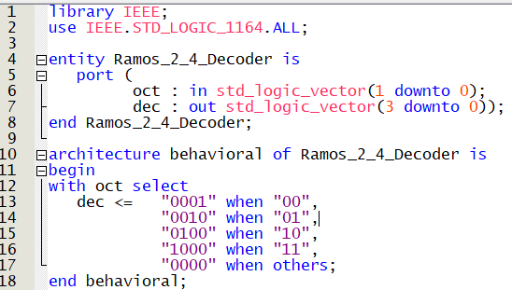
Task 2.1: 2-to-4 Decoder
Figure 2: VHDL code for 2-to-4 Decoder

Slide 4
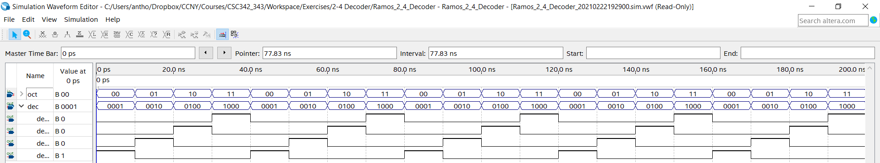
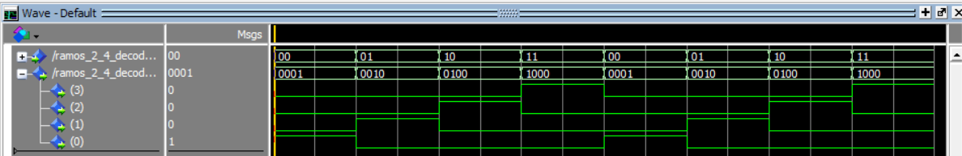
Task 2.1: 2-to-4 Decoder
Figure 3: 2-to-4 Decoder Simulation

Slide 5
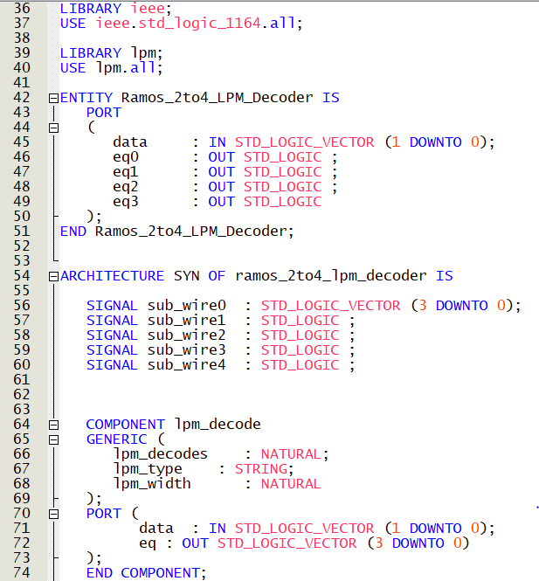
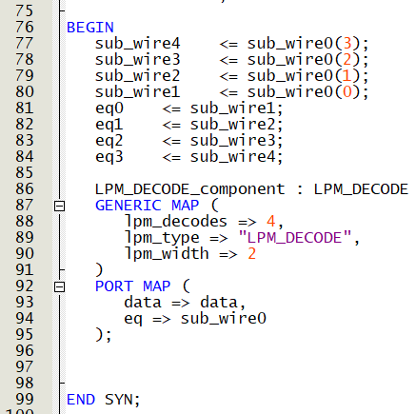
Task 2.2: 2-to-4 Decoder Using LPM
Figure 4: VHDL code for 2-to-4 Decoder using LPM

Slide 6
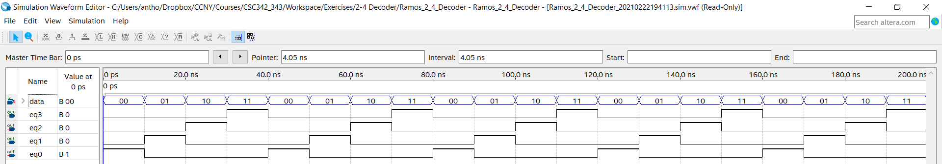
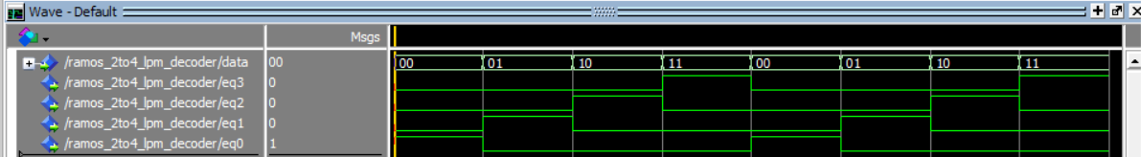
Task 2.2: 2-to-4 Decoder Using LPM
Figure 5: 2-to-4 Decoder LPM Simulation

Slide 7



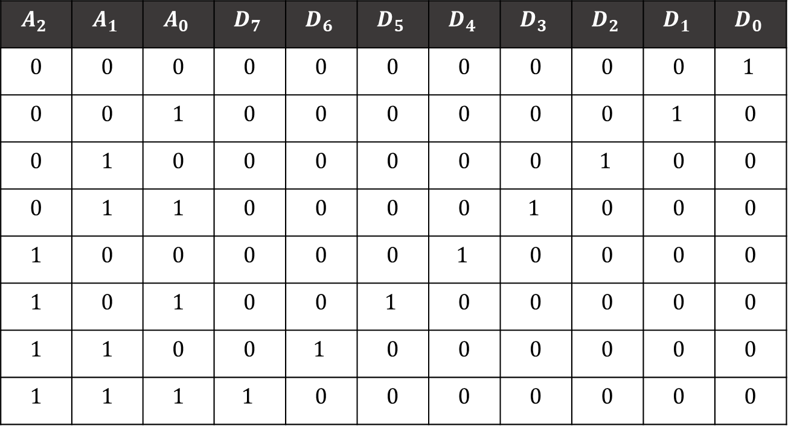





3-to-8 Decoder
$$A_{2}$$ | $$A_{1}$$ | $$A_{0}$$ | $$D_{7}$$ | $$D_{6}$$ | $$D_{5}$$ | $$D_{4}$$ | $$D_{3}$$ | $$D_{2}$$ | $$D_{1}$$ | $$D_{0}$$
0 | 0 | 0 | 0 | 0 | 0 | 0 | 0 | 0 | 0 | $$1$$
0 | 0 | 1 | 0 | 0 | 0 | 0 | 0 | 0 | $$1$$ | 0
0 | 1 | 0 | 0 | 0 | 0 | 0 | 0 | $$1$$ | 0 | 0
0 | 1 | 1 | 0 | 0 | 0 | 0 | $$1$$ | 0 | 0 | 0
1 | 0 | 0 | 0 | 0 | 0 | $$1$$ | 0 | 0 | 0 | 0
1 | 0 | 1 | 0 | 0 | $$1$$ | 0 | 0 | 0 | 0 | 0
1 | 1 | 0 | 0 | $$1$$ | 0 | 0 | 0 | 0 | 0 | 0
1 | 1 | 1 | $$1$$ | 0 | 0 | 0 | 0 | 0 | 0 | 0
$$D_{7}=A_{0}∙A_{1}∙A_{2}$$
$$D_{6}=\overline{A_{0}}∙A_{1}∙A_{2}$$
$$D_{5}=A_{0}∙\overline{A_{1}}∙A_{2}$$
$$D_{4}=\overline{A_{0}}∙\overline{A_{1}}∙A_{2}$$
$$D_{3}=A_{0}∙A_{1}∙\overline{A_{2}}$$
$$D_{2}=\overline{A_{0}}∙A_{1}∙\overline{A_{2}}$$
$$D_{1}=A_{0}∙\overline{A_{1}}∙\overline{A_{2}}$$
$$D_{0}=\overline{A_{0}}∙\overline{A_{1}}∙\overline{A_{2}}$$
Figure 6: Truth Table for 3-to-8 Decoder

Slide 8
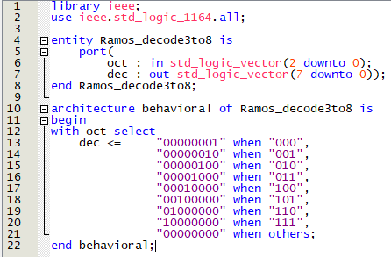
Task 2.3: 3-to-8 Decoder
Figure 7: VHDL code for 3-to-8 Decoder

Slide 9
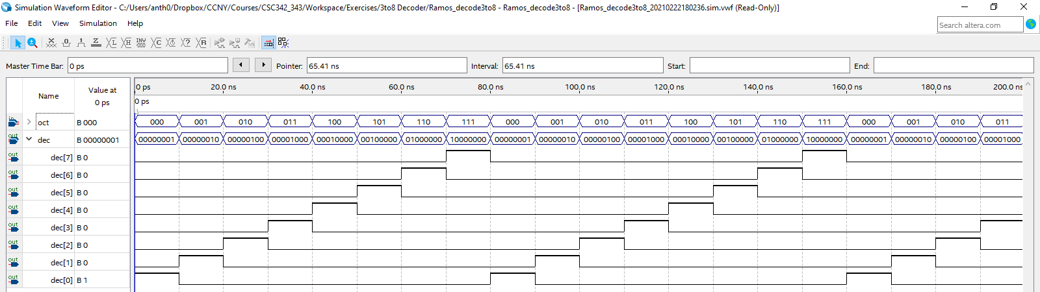
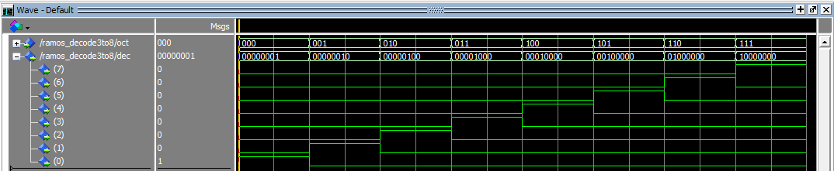
Task 2.3: 3-to-8 Decoder
Figure 8: 3-to-8 Decoder Simulation

Slide 10
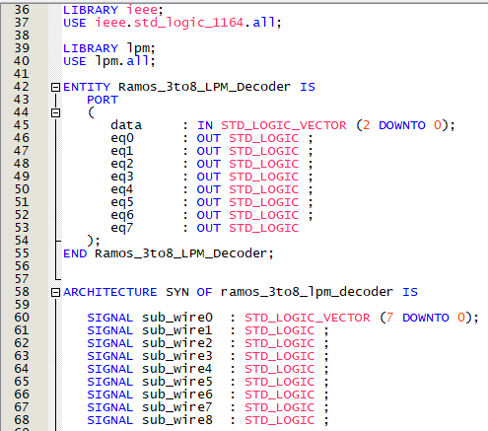
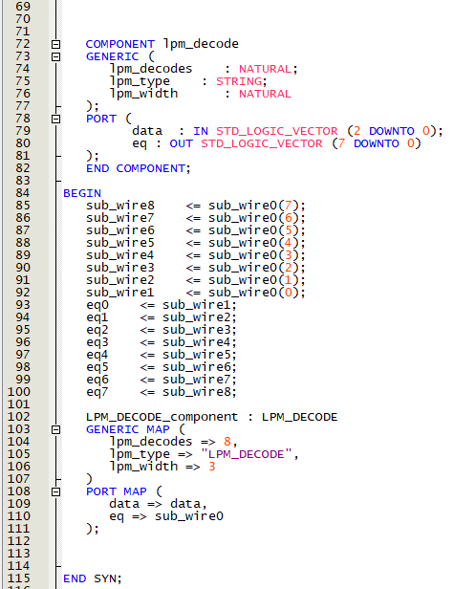
Task 2.4: 3-to-8 Decoder Using LPM
Figure 9: VHDL code for 3-to-8 Decoder using LPM

Slide 11
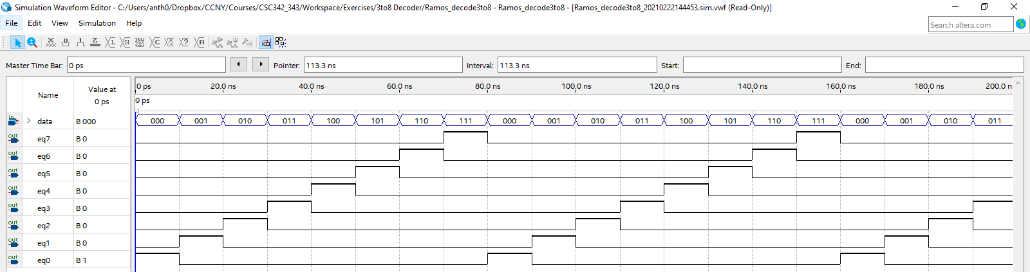
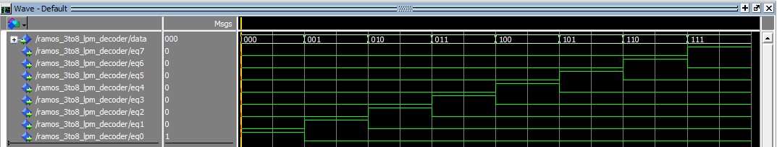
Task 2.4: 3-to-8 Decoder Using LPM
Figure 10: 3-to-8 Decoder LPM Simulation

Slide 12

Verification of Decoder Design
The waveforms verify the correctness of the decoder design because for both the 2-to-4 and 3-to-8 decoders, their behavior follows their respective truth tables. Namely, given an input A of length 2 ($A_{0}…A_{1})$, for example, only one data line from an output list ($D_{0}…D_{3})$ will receive a binary string of length of $2^{2}=4$ bits.

Slide 13
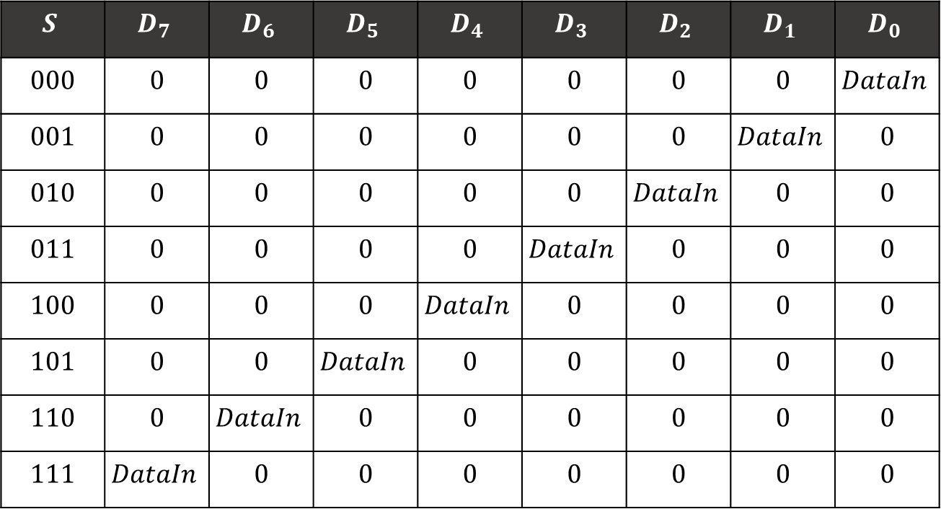
1-to-8 Demultiplexer
$$S$$ | $$D_{7}$$ | $$D_{6}$$ | $$D_{5}$$ | $$D_{4}$$ | $$D_{3}$$ | $$D_{2}$$ | $$D_{1}$$ | $$D_{0}$$
000 | 0 | 0 | 0 | 0 | 0 | 0 | 0 | $$DataIn$$
001 | 0 | 0 | 0 | 0 | 0 | 0 | $$DataIn$$ | 0
010 | 0 | 0 | 0 | 0 | 0 | $$DataIn$$ | 0 | 0
011 | 0 | 0 | 0 | 0 | $$DataIn$$ | 0 | 0 | 0
100 | 0 | 0 | 0 | $$DataIn$$ | 0 | 0 | 0 | 0
101 | 0 | 0 | $$DataIn$$ | 0 | 0 | 0 | 0 | 0
110 | 0 | $$DataIn$$ | 0 | 0 | 0 | 0 | 0 | 0
111 | $$DataIn$$ | 0 | 0 | 0 | 0 | 0 | 0 | 0
Figure 11: Truth Table for 1-to-8 Demultiplexer

Slide 14
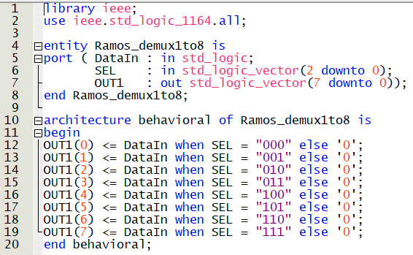
Task 2.5: 1-to-8 Demultiplexer
Figure 12: VHDL code for 1-to-8 Demultiplexer

Slide 15
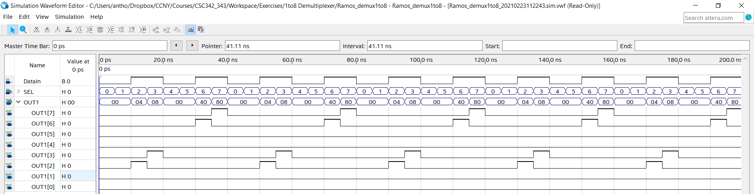
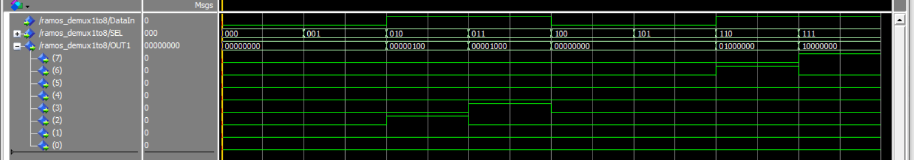
Task 2.5: 1-to-8 Demultiplexer
Figure 13: 1-to-8 Demultiplexer Simulation

Slide 16
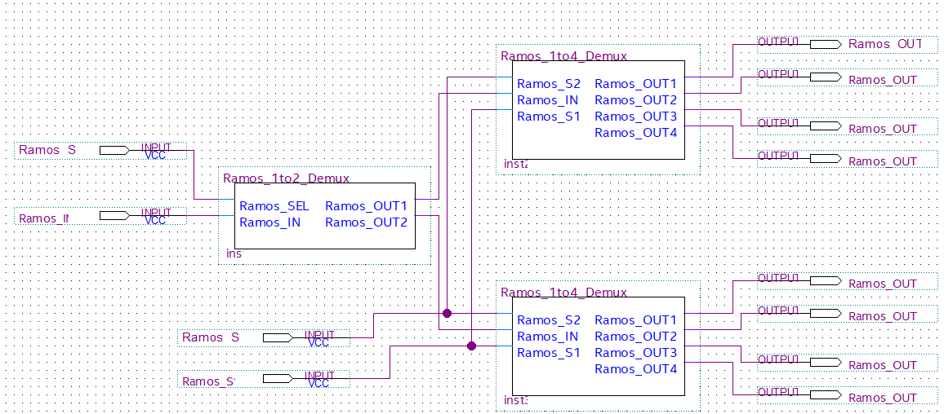
Task 2.6
Figure 14: 1-to-8 Demultiplexer Schematic using a 2:1 Demux and two 4:1 Demuxes

Slide 17
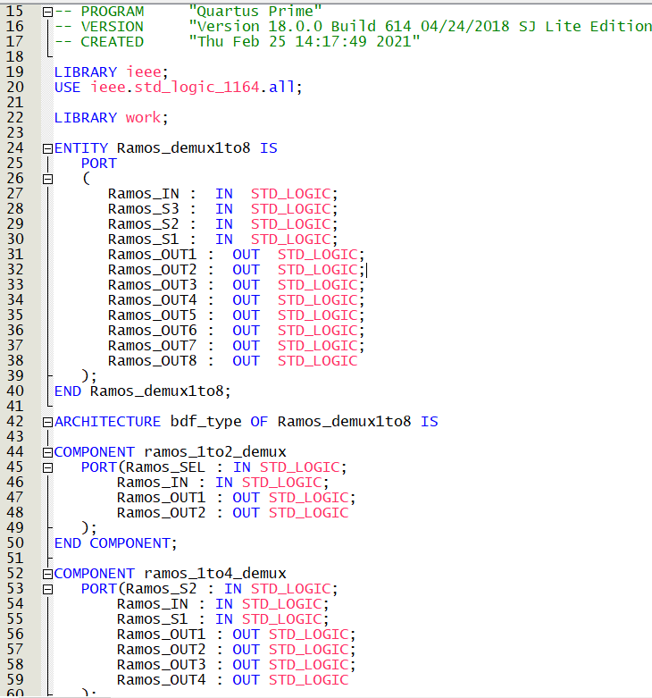
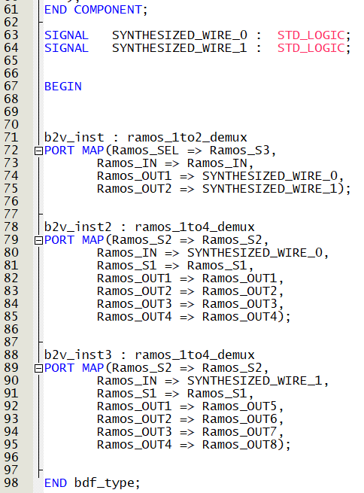
Task 2.6
Figure 15: Generated VHDL code from schematic

Slide 18
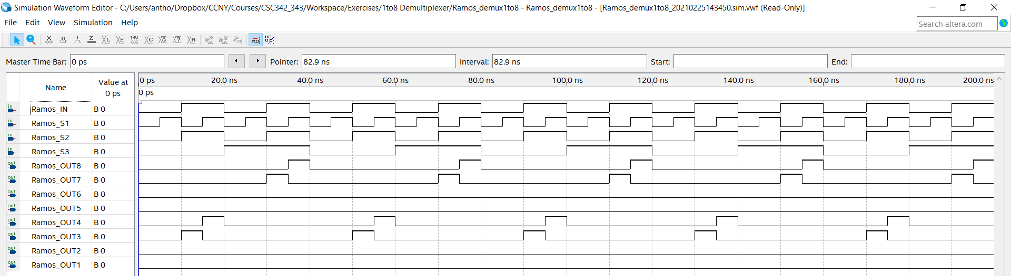
Task 2.6
Figure 16: 1-to-8 Demultiplexer Simulation (Schematic)

Slide 19

Verification of Demultiplexer Design
The waveforms show that given an input and a selector, the input is fed into one of eight possible output ports (OUT1(0) to OUT(7)). The selector has seven possible values (${000}_{2}$ – ${111}_{2}$). Using the truth table, when the selector is ${000}_{2}$, the input is fed to OUT(0) only. Likewise, when the selector is ${001}_{2}$, the input is fed to OUT(1) only.

